Slide 1
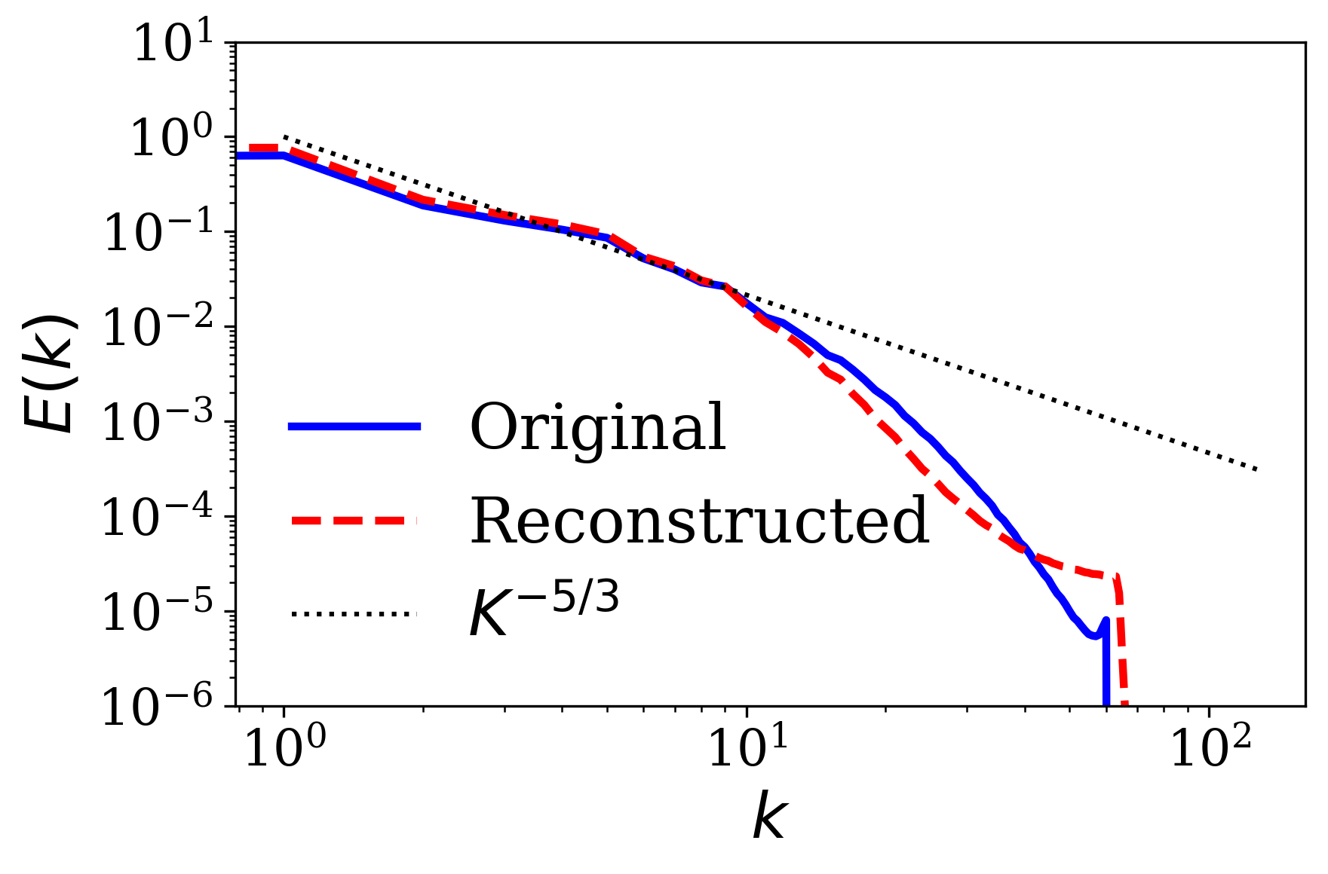
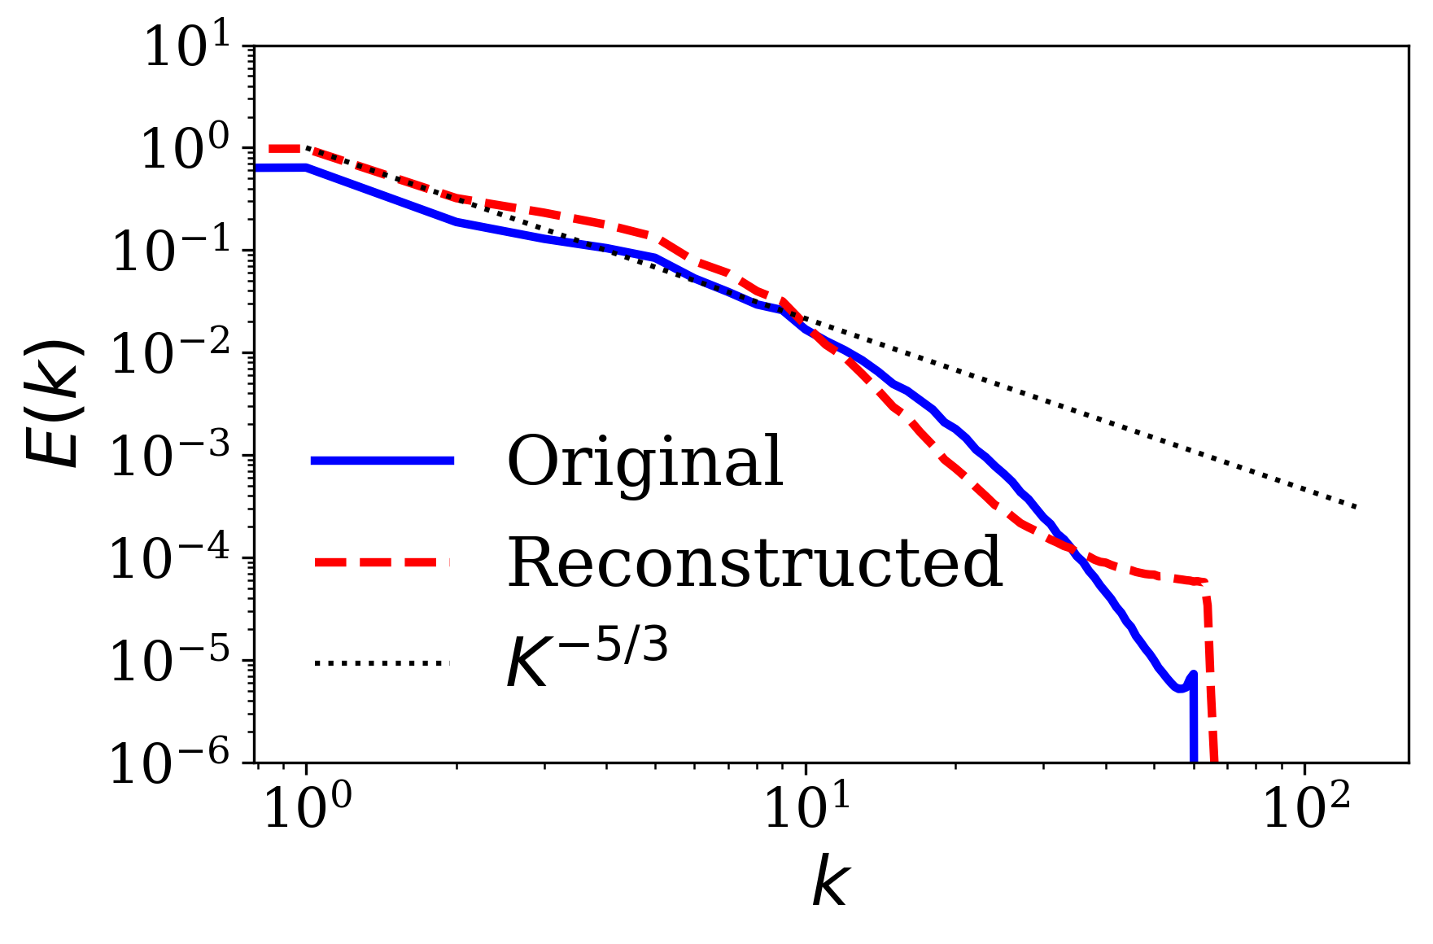
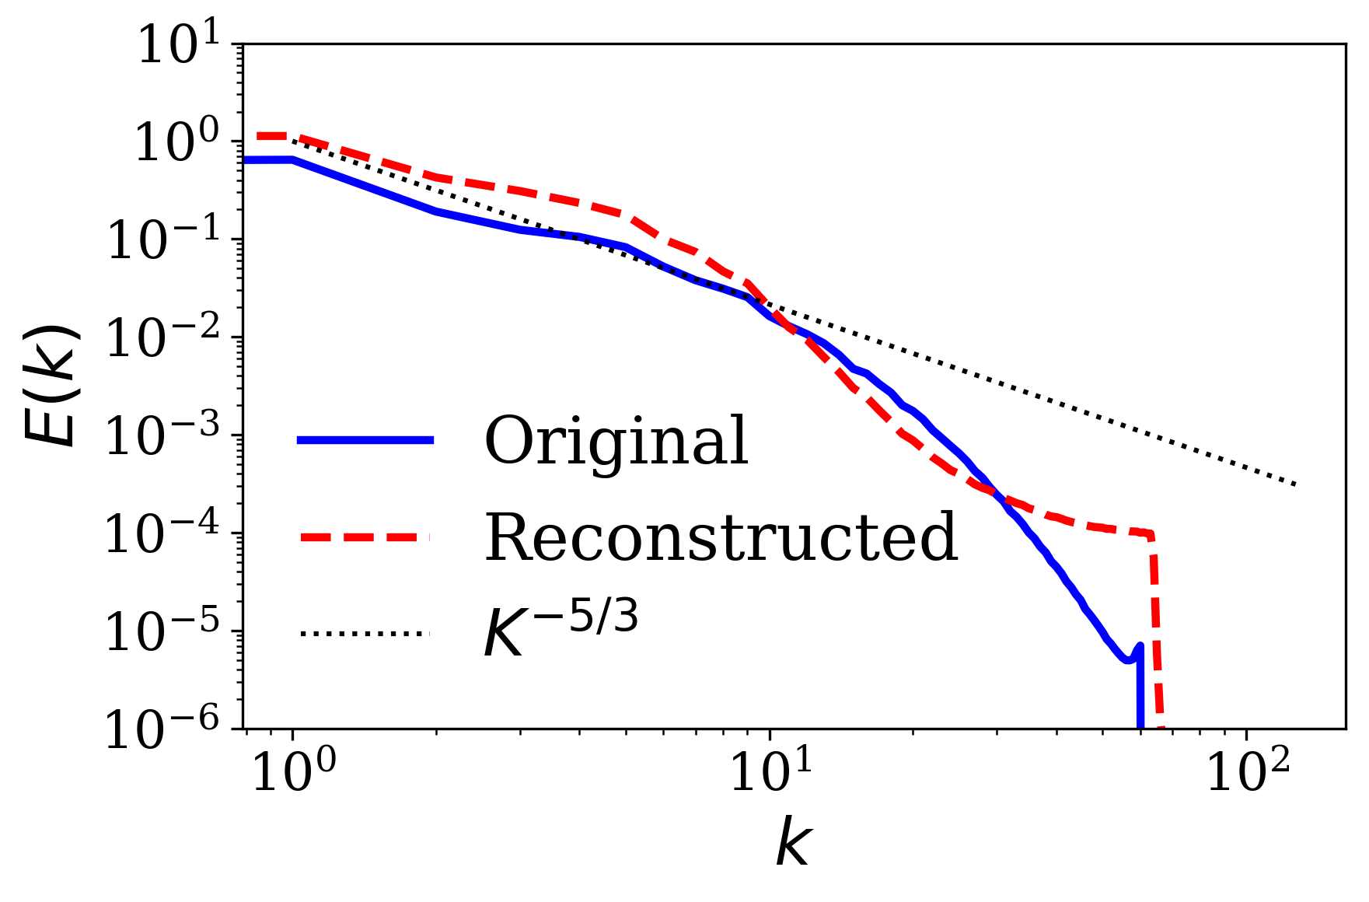
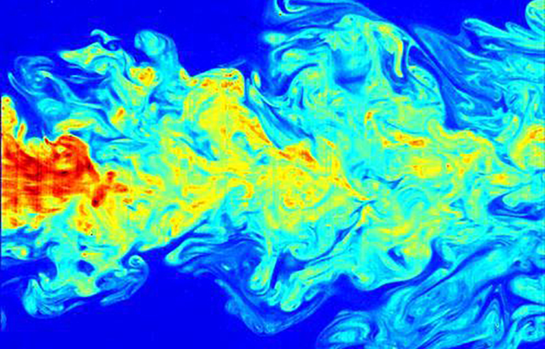
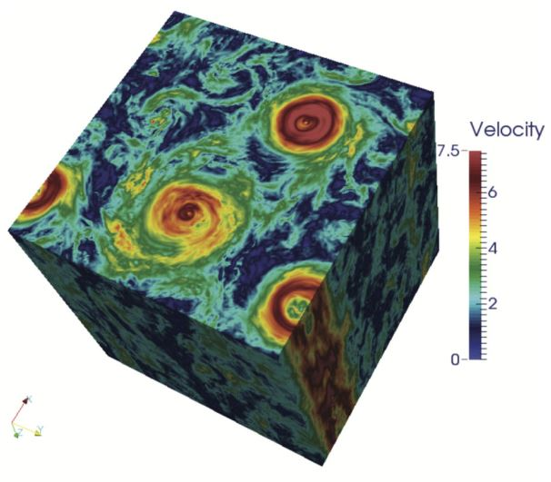
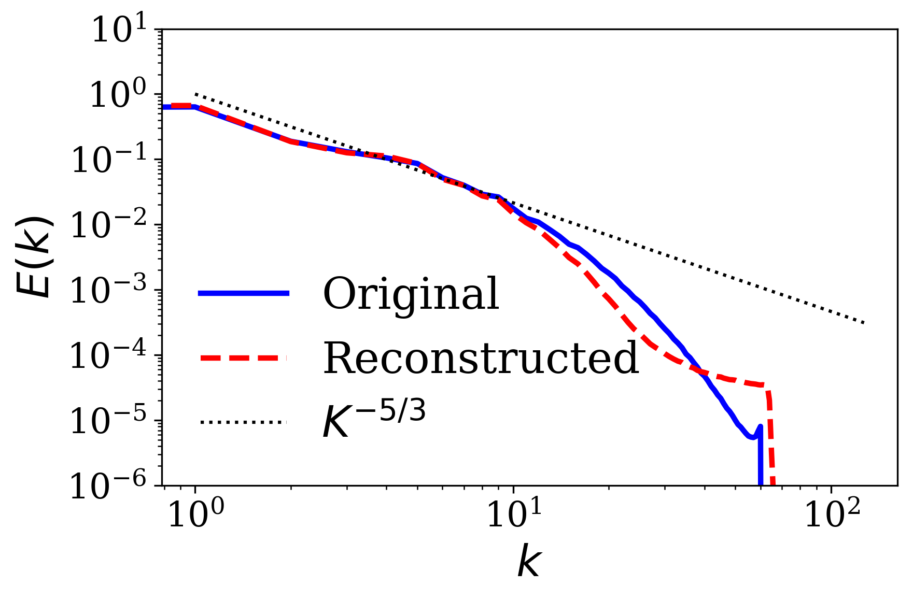
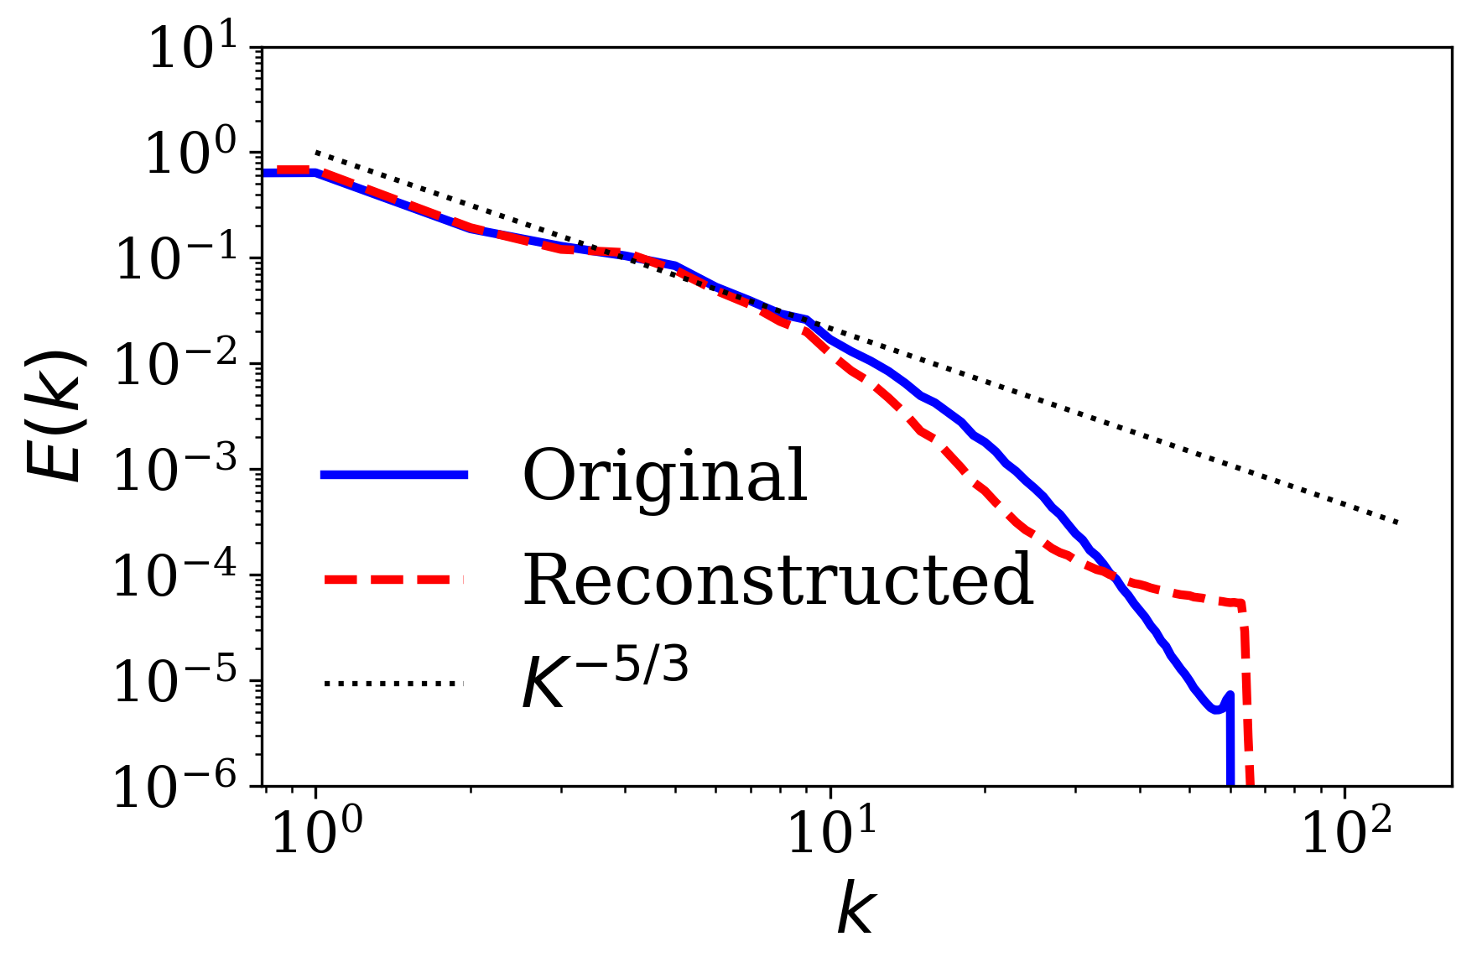
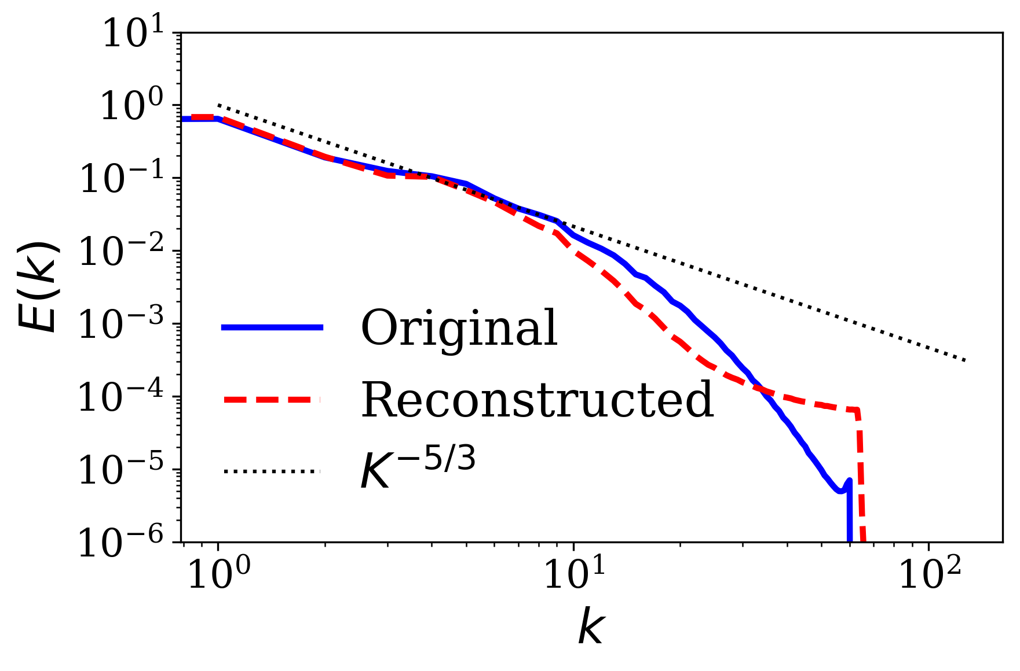
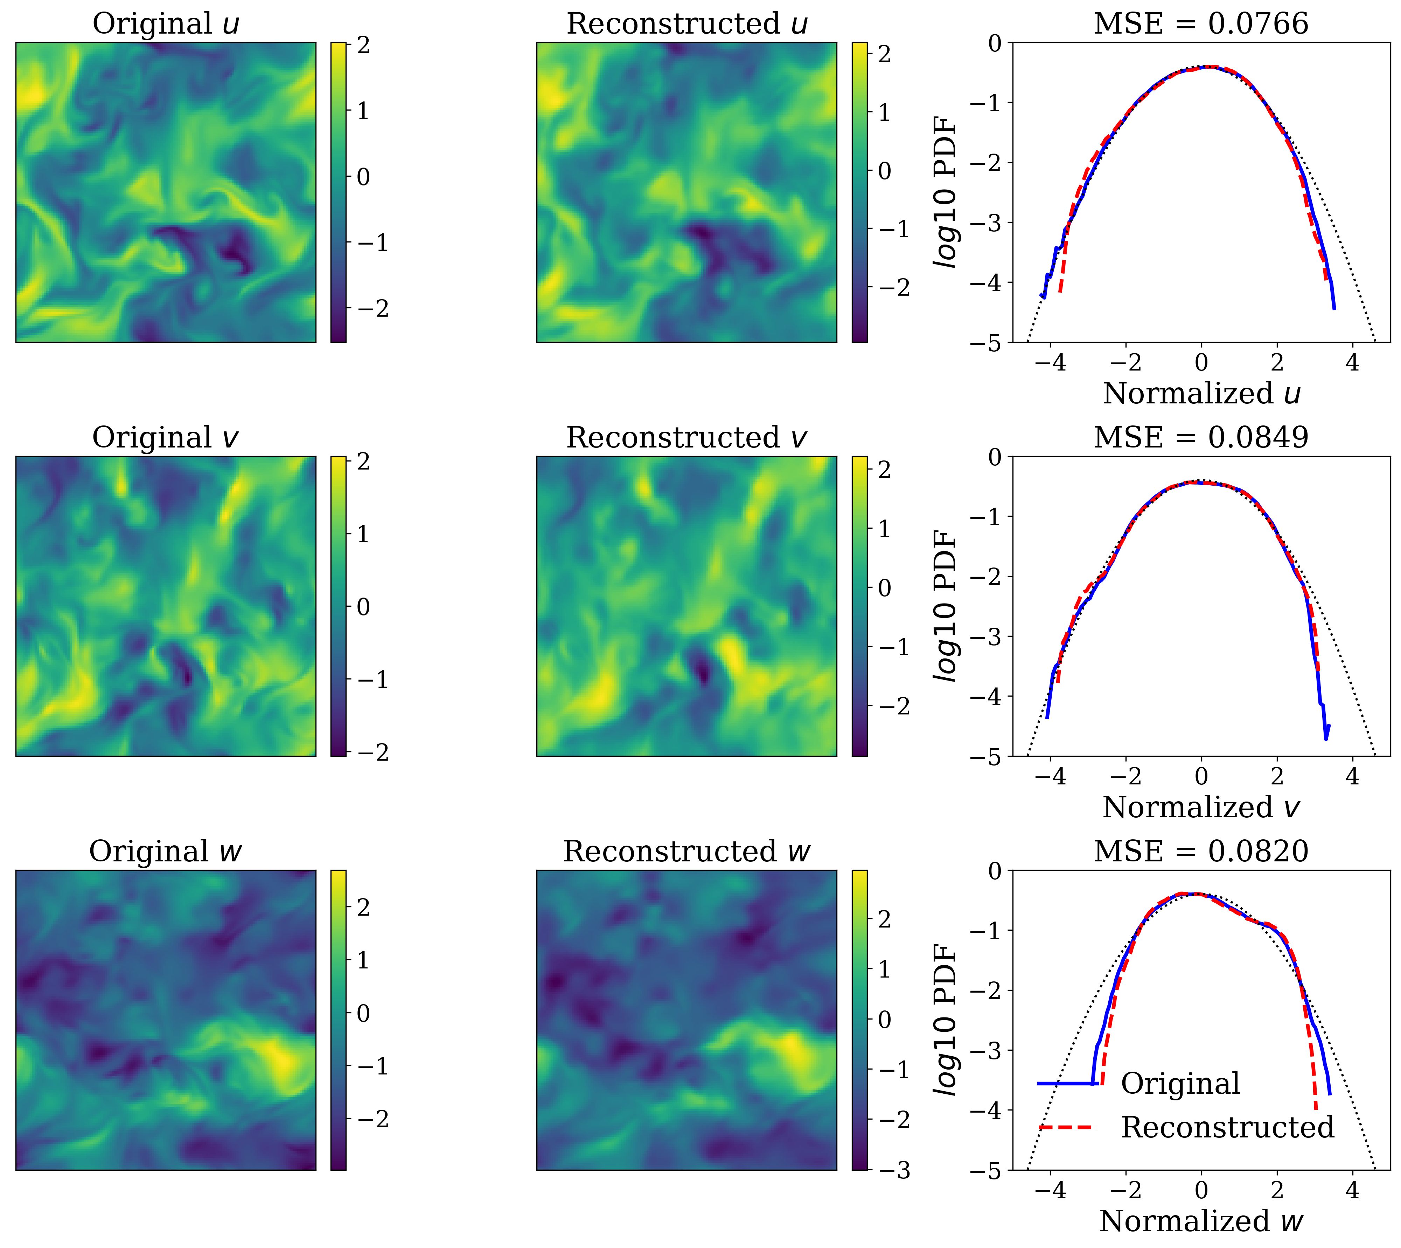
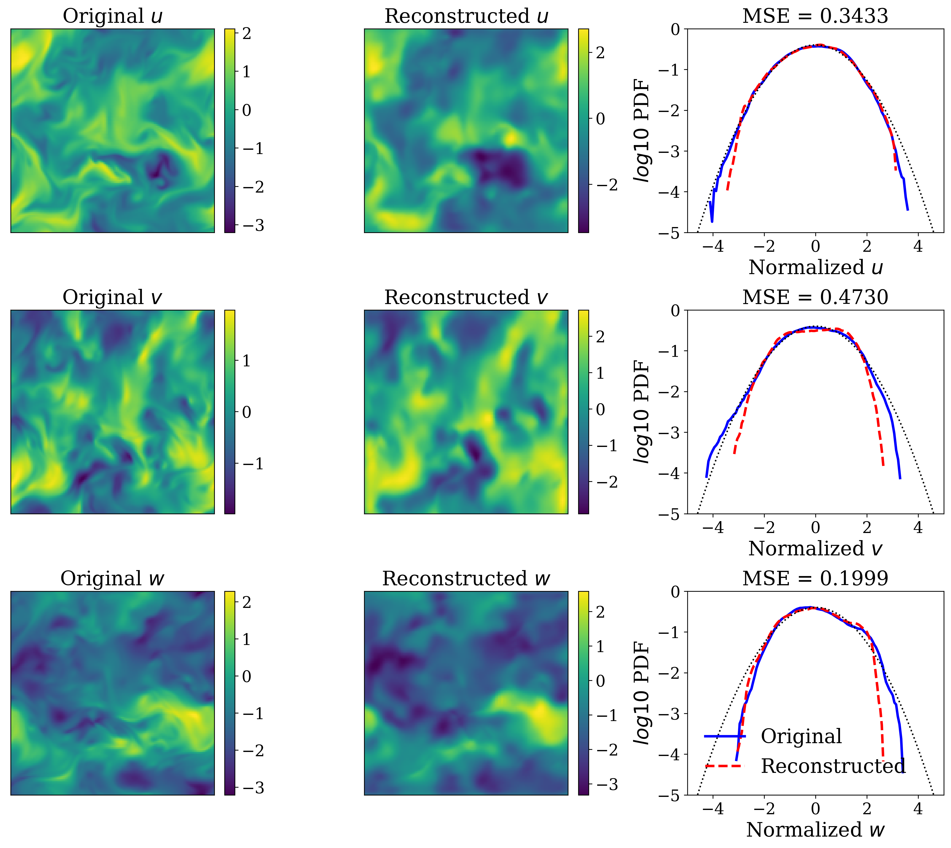
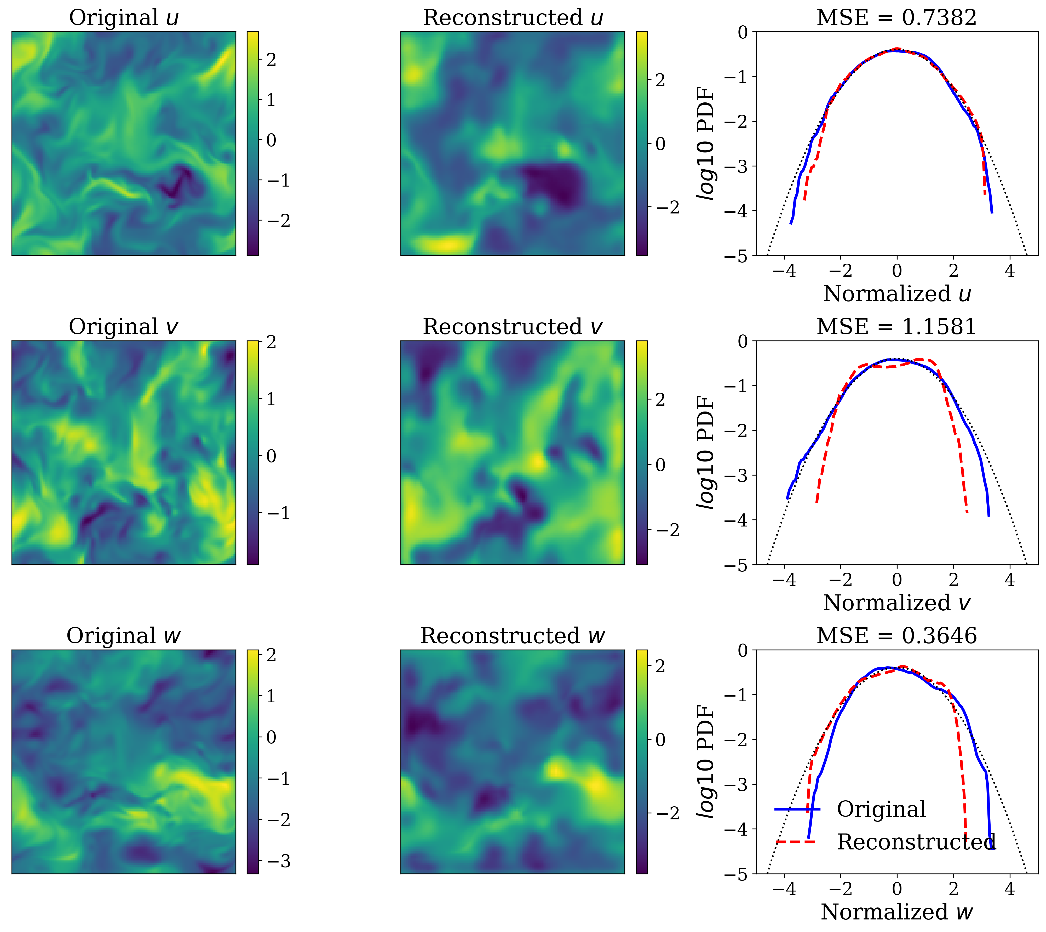
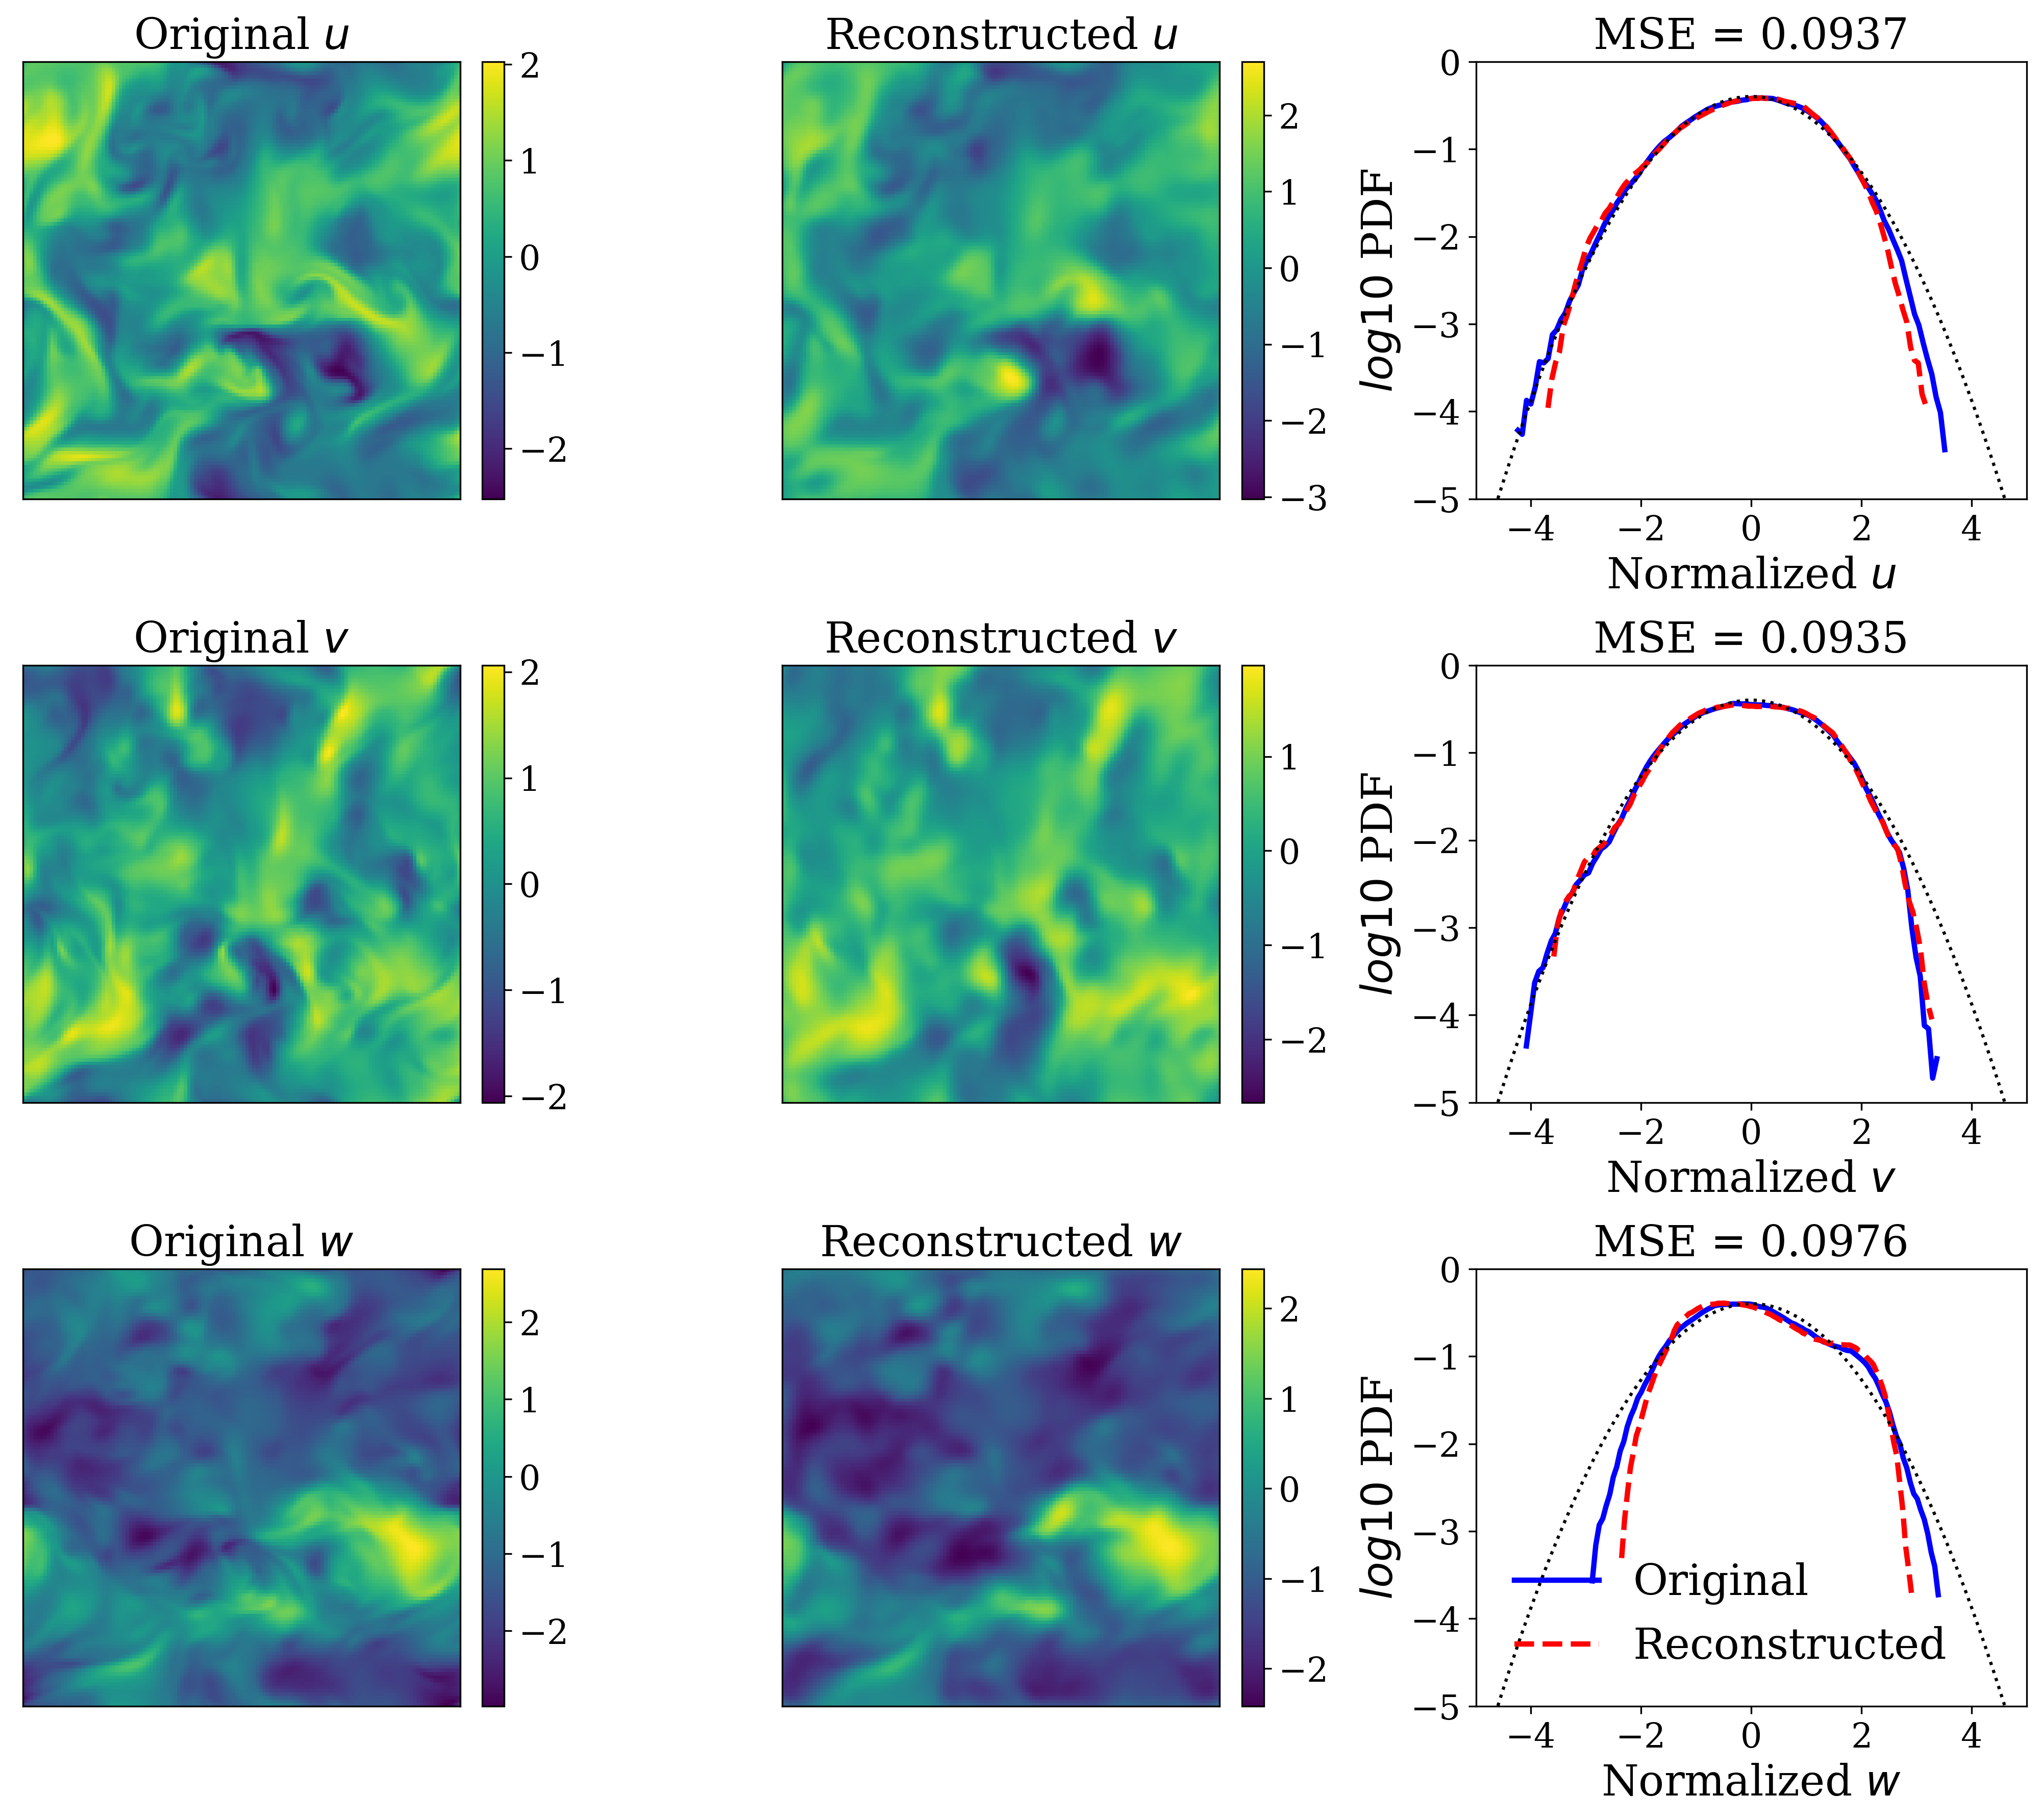
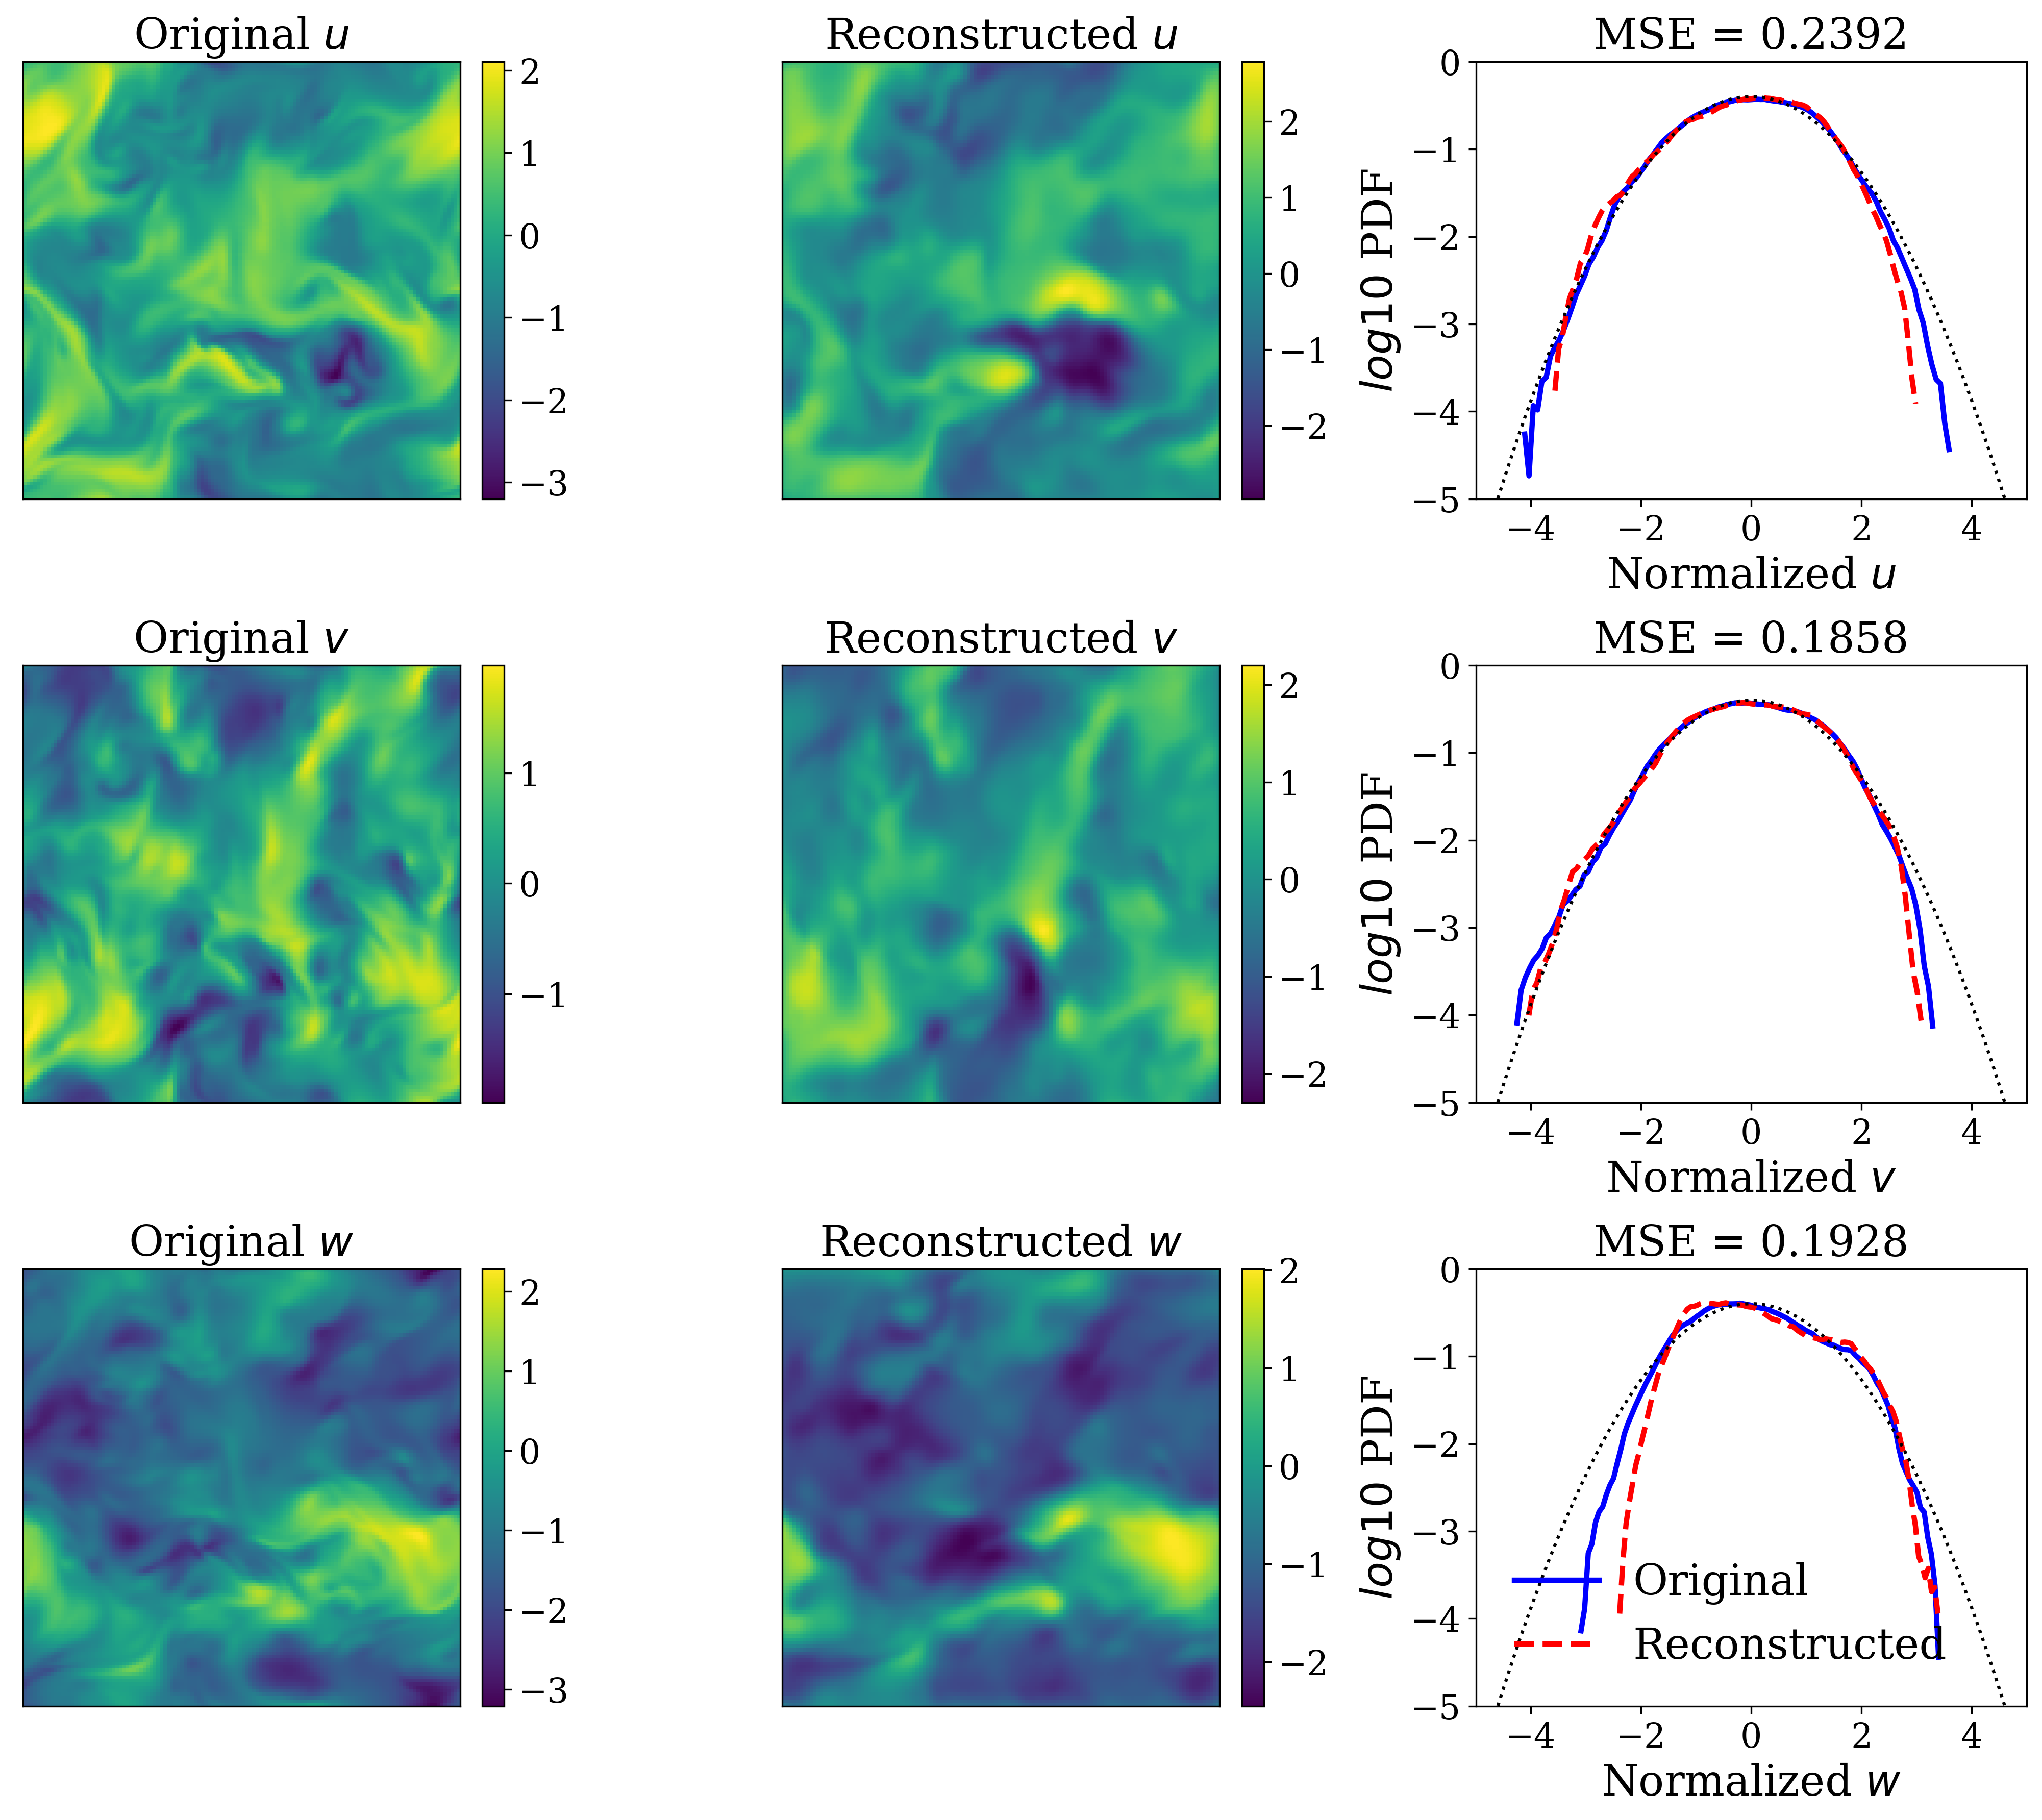
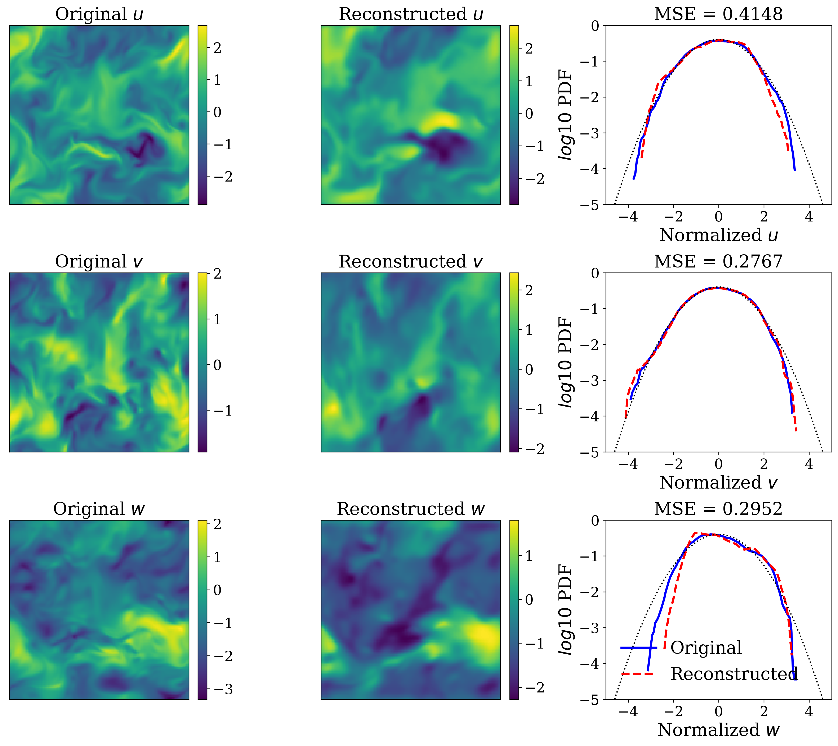
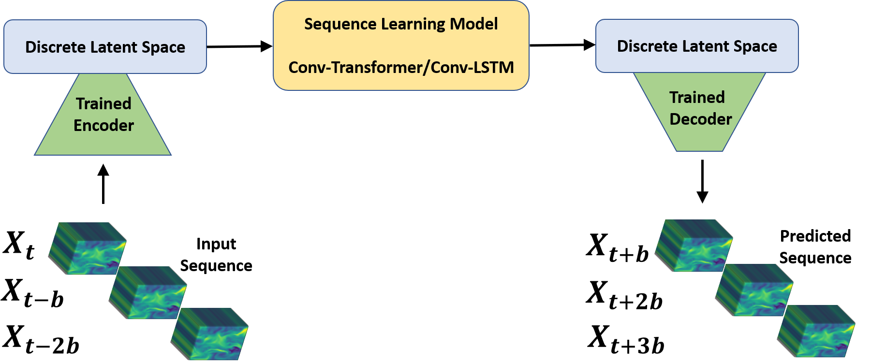
Emulating Spatio-Temporal Realizations of Three-Dimensional Isotropic Turbulence via Deep Sequence Learning Models
Mohammadreza Momenifar, Enmao Diao Vahid Tarokh, Andrew D. Bragg
Introduction and Motivation
Turbulence is a complex dynamical system which is strongly high-dimensional, multi-scale, non-linear, non-local and chaotic with a broad range of correlated scales that vary over space and time. A major pursuit and fundamental task of turbulence community is to develop new modeling techniques to characterize dynamics of turbulence that evolve over time and space while varying over a broad range of spatio-temporal scales. The primary goal of this research is to utilize modern deep learning technique to simulate high-fidelity three-dimensional velocity field of turbulent flow realizations that respect turbulence characteristics without solving the full Navier-Stokes (NS) equations.
These architectures are designed and trained to perform a sequence to sequence multi-class classification task in which they take an input sequence with a fixed length (k) and predict a sequence with a fixed length (p), representing the future time instants of the flow. Our compression model is a Vector-Quantized Autoencoder (VQ-AE), proposed in our recent work ([1]). For the sequence learning model, we designed and trained two radically different sequence learning models, convolutional LSTM (Conv-LSTM) and convolutional Transformer (Conv-Transformer).
The turbulent kinetic energy (TKE) spectra of the predicted time instants are shown in Figure 2 for the Conv-LSTM and Conv-Transformer models.
Results
In all of the diagnostics tests, we observe that the accuracy of results deteriorates from the first to the third predicted snapshots. This is quite expected as the error propagates from the first predictions to the next ones due to autoregressive nature of the predictions.
In Figure 1, we evaluate the performance of Conv-LSTM and Conv-Transformer models in reconstructing 2d snapshots of the velocity field, as well as the PDFs of the velocity components.
(a) Conv-LSTM, 𝑡+𝑏
(b) Conv-LSTM, 𝑡+2𝑏
(c) Conv-LSTM, 𝑡+3𝑏
Velocity field of turbulent flow
(d) Conv-Transformer, 𝑡+𝑏
(e) Conv-Transformer, 𝑡+2𝑏
(f) Conv-Transformer, 𝑡+3𝑏
Method
Figure 2: Predictions of turbulent kinetic energy (TKE) using (a-c) Conv-LSTM and (d-f) Conv-Transformer models
We leverage high-fidelity DNS data which come from solving the NS equations on a three-dimensional mesh. Given the grid-based discretization of our computational domain, we can benefit from modern computer vision approaches in our modeling framework, particularly Convolutional Neural Networks (CNN). Since the size of the dataset is memory intensive, we first generate a low-dimensional representation of the velocity data, and then pass it to a sequence prediction network that learns the spatial and temporal correlations of the underlying data.
our framework consists of two deep learning models, one for compression and the other for sequence learning, which are trained separately.
While the reconstruction quality decreases for the Conv-LSTM model from the first to the third predictions, our Conv-Transformer model accurately captures the large and inertial scales of flow with significant loss of information for the smallest scales.
(a) Conv-LSTM, 𝑡+𝑏
(b) Conv-LSTM, 𝑡+2𝑏
(c) Conv-LSTM, 𝑡+3𝑏
Conclusion
Based on our diagnostics tests, the Conv-Transformer model outperforms the Conv-LSTM one and can accurately, both quantitatively and qualitatively, retain the large scales, capture well the inertial scales of flow but fail at recovering the small and intermittent fluid motions. The outperfor-
mance of Conv-Transformer model can be heavily attributed to its ability to process input sequences as a whole rather than element by element (which is typical in LSTM model)
(d) Conv-Transformer, 𝑡+𝑏
(e) Conv-Transformer, 𝑡+2𝑏
(f) Conv-Transformer, 𝑡+3𝑏
Figure 1: Predictions of velocity field using (a-c) Conv-LSTM and (d-f) Conv-Transformer models.
The results show that for the first prediction time step both models capture reasonably well, Conv-LSTM is slightly better than Conv-Transformer, the instantaneous spatial structure of the flow and the statistical properties of the velocity field. Although the accuracy of reconstructed snapshots decreases for the next predictions due to the error propagation, we clearly observe that the quality of predicted snapshots using Conv-Transformer is much better.
References
[1] Momenifar, M., Diao, E., Tarokh, V., & Bragg, A. D. (2021). Dimension Reduced Turbulent Flow Data From Deep Vector Quantizers. arXiv preprint arXiv:2103.01074.
[2] Momenifar, M., Diao, E., Tarokh, V., & Bragg, A. D. (2021). Emulating Spatio-Temporal Realizations of Three-Dimensional Isotropic Turbulence via Deep Sequence Learning Models. arXiv preprint arXiv:2112.03469.
Schematic of our sequence learning framework

